Slide 1
Lecture -1 Sequential Circuit Design Latches and Flip-Flops

Slide 2
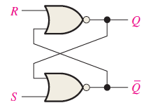
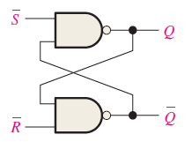
Latches
A latch is a temporary storage device that has two stable states (bi-stable).
It is a basic form of temporary storage device which can reside in either 1 or 0.
The S-R (Set-Reset) latch is the most basic type.
It can be constructed from two cross-coupled NOR gates or NAND gates.
With NOR gates the latch responds to active-HIGH inputs.
With NAND gates the latch responds to active-LOW inputs.
An Active-HIGH S-R Latch
An Active-LOW S-R Latch

Slide 3
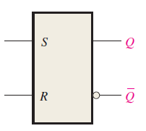
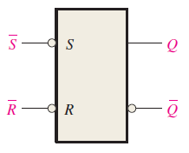
Latches
Block diagram of an Active-HIGH S-R Latch
For an Active-HIGH S-R Latch there are no bubbles in the inputs.
Block diagram of an Active-LOW S-R Latch
For an Active-LOW S-R Latch there are bubbles in the inputs.

Slide 4
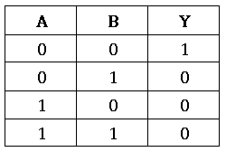
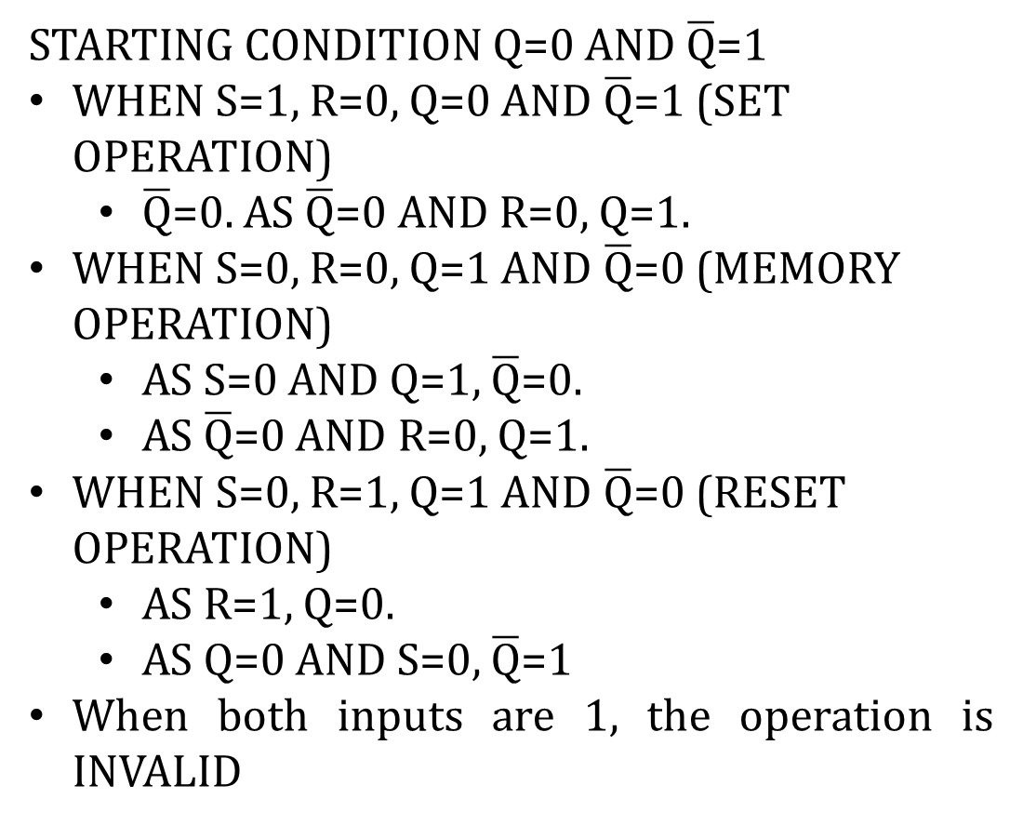
Latches
Operation of an Active-HIGH S-R Latch
STARTING CONDITION Q=0 AND $\overline{Q}$=1
WHEN S=1, R=0, Q=0 AND $\overline{Q}$=1 (SET OPERATION)
$\overline{Q}$=0. AS $\overline{Q}$=0 AND R=0, Q=1.
WHEN S=0, R=0, Q=1 AND $\overline{Q}$=0 (MEMORY OPERATION)
AS S=0 AND Q=1, $\overline{Q}$=0.
AS $\overline{Q}$=0 AND R=0, Q=1.
WHEN S=0, R=1, Q=1 AND $\overline{Q}$=0 (RESET OPERATION)
AS R=1, Q=0.
AS Q=0 AND S=0, $\overline{Q}$=1
When both inputs are 1, the operation is INVALID
Truth-table for NOR gate

Slide 5
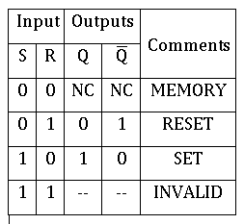
Latches
Table of operation of an Active-HIGH S-R Latch

Slide 6
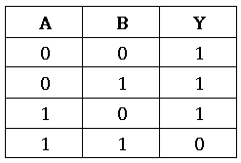
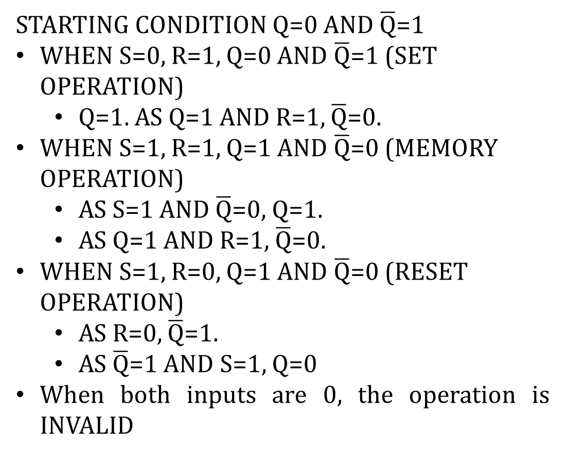
Latches
Operation of an Active-LOW S-R Latch
STARTING CONDITION Q=0 AND $\overline{Q}$=1
WHEN S=0, R=1, Q=0 AND $\overline{Q}$=1 (SET OPERATION)
Q=1. AS Q=1 AND R=1, $\overline{Q}$=0.
WHEN S=1, R=1, Q=1 AND $\overline{Q}$=0 (MEMORY OPERATION)
AS S=1 AND $\overline{Q}$=0, Q=1.
AS Q=1 AND R=1, $\overline{Q}$=0.
WHEN S=1, R=0, Q=1 AND $\overline{Q}$=0 (RESET OPERATION)
AS R=0, $\overline{Q}$=1.
AS $\overline{Q}$=1 AND S=1, Q=0
When both inputs are 0, the operation is INVALID
Truth-table for NAND gate

Slide 7
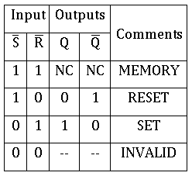
Latches
Table of operation of an Active-LOW S-R Latch

Slide 8
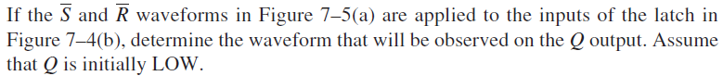
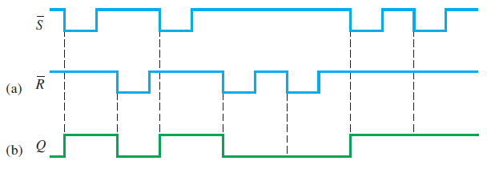
Latches
Exercise 1:
SOLUTION

Slide 9
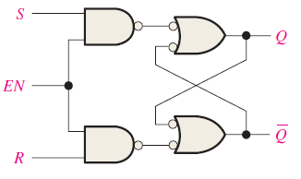
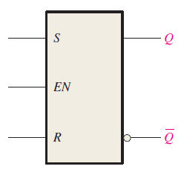
Gated S-R Latches
A gated latch is a variation of basic latch.
A gated latch has an extra input “ENABLE” (EN).
The latch responds to S and R if and only if EN is HIGH.
So the extra input brings more control over the operation.
Gated Latches are level sensitive.
A gated S-R Latch
Block diagram of a gated S-R Latch

Slide 10
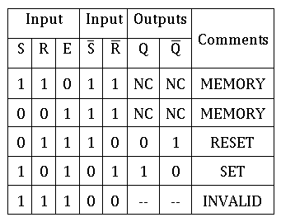
Gated S-R Latches
Logic Circuit of a gated S-R Latch
Table of operation for a gated S-R Latch
Truth table for a NAND gate

Slide 11
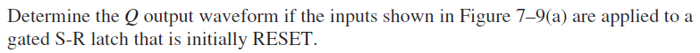
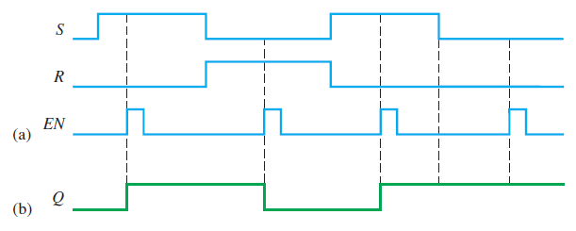
Gated S-R Latches
Exercise 2:
SOLUTION

Slide 12
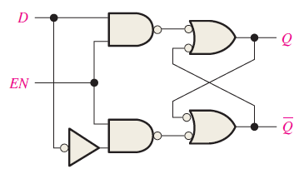
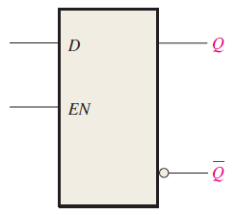
Gated D Latches
The D latch is another variant of latches
It combines the S and R input into a single input D.
When D and EN is HIGH, the latch is SET.
When D is LOW and EN is HIGH, the latch is RESET.
A simple rule is, when EN is HIGH, the Q follows the input D
A gated D-Latch
Block diagram of a gated D-Latch

Slide 13
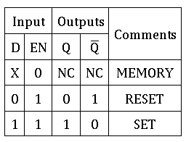
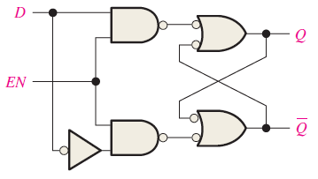
Gated D Latches
Logic Circuit of a Gated D-Latch
Table of operation for Gated D-Latch

Slide 14
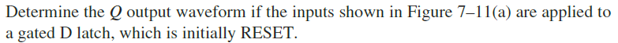
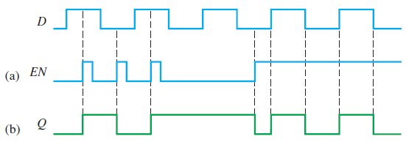
Gated D Latches
Exercise 3:
SOLUTION

Slide 15
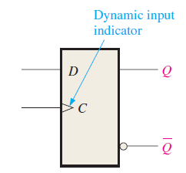
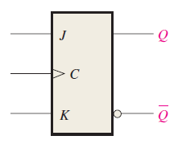
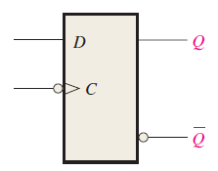
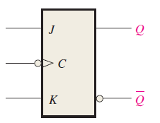
Flip-Flops
Flip-Flops are synchronous bi-stable devices, also know as bi-stable multi-vibrator.
Synchronous means the output changes only at the triggering of a control input “Clock”.
Compared to gated latches, flip-flops are edge triggered devices.
Edge triggered means, the output only changes at “Rising Edge” or “Falling Edge” of a clock.
A rising edge triggered device is also called a positive edge triggered device.
A falling edge triggered device is also called a negative edge triggered device.
a) D Flip-Flop
b) J-K Flip-Flop
a) D Flip-Flop
b) J-K Flip-Flop
Positive edge triggered Flip-Flops
Negative edge triggered Flip-Flops

Slide 16
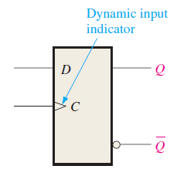
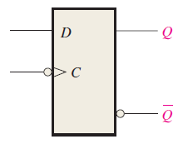
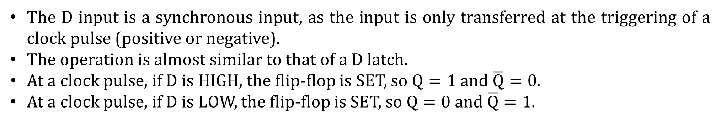
D Flip-Flops
The D input is a synchronous input, as the input is only transferred at the triggering of a clock pulse (positive or negative).
The operation is almost similar to that of a D latch.
At a clock pulse, if D is HIGH, the flip-flop is SET, so $Q=1$and $\overline{Q}=0$.
At a clock pulse, if D is LOW, the flip-flop is SET, so $Q=0$and $\overline{Q}=1$.
Positive edge triggered D-flip flop
Negative edge triggered D-flip flop

Slide 17
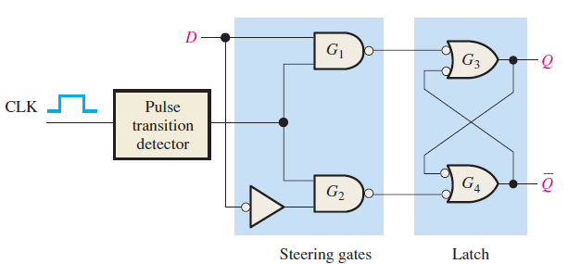
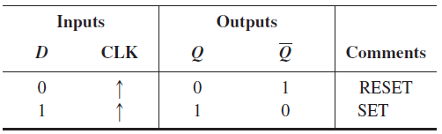
D Flip-Flops
a) Operation table of positive edge triggered D flip-flop
b) Positive edge triggered D flip-flop
In the operation table, the arrow indicates the rising edge, and thus it is a positive edge triggered D flip-flop.
Rising edge is indicated by an upward arrow, likewise, a falling edge is indicated by a downward value.
The circuit diagram of a D flip-flop is also similar to a gated D Latch, except for an additional pulse transition detector.
The pulse transition detector is used to produce the triggering edge.

Slide 18
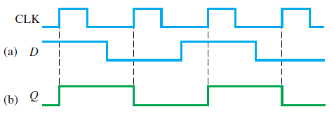
D Flip-Flops
Exercise 4:
SOLUTION

Slide 19
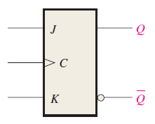
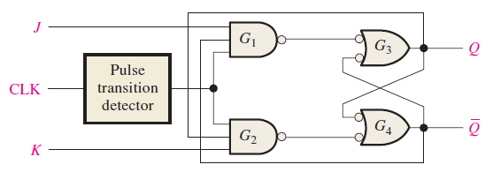
JK Flip-Flops
The JK Flip-Flop is a more versatile and widely used type of Flip-Flop.
The J and K inputs are synchronous inputs.
The JK flip-flop eradicates the problem of SR flip-flop.
JK flip-flops does not have the invalid state.
When both J and K are HIGH, a JK flip-flop performs the toggle operation.
JK flip-flops are widely used to make counters.
Block diagram of positive-edge triggered J-K flip-flop
Logic circuit of positive-edge triggered J-K flip-flop

Slide 20
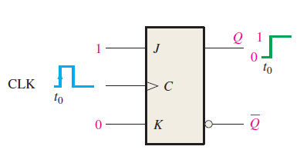
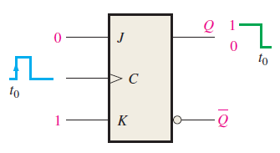
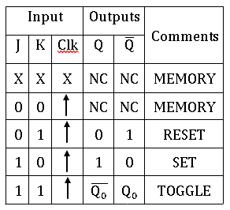
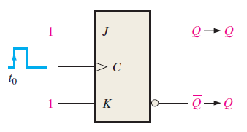
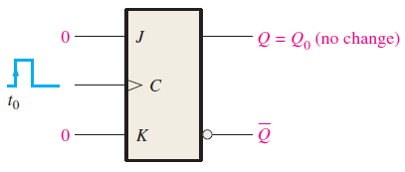
JK Flip-Flops
Set Operation
Reset Operation
Characteristic table of positive-edge triggered J-K flip-flop
Toggle Operation
Memory Operation

Slide 21
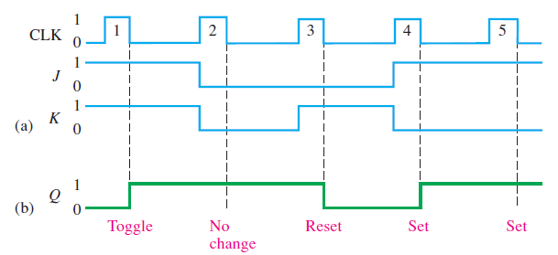
JK Flip-Flops
Exercise 5:
SOLUTION

Slide 22
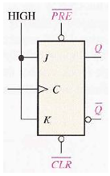
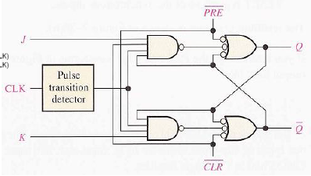
JK Flip-Flops with Asynchronous Inputs
Most flip-flops also have asynchronous inputs other than their synchronous inputs.
The asynchronous inputs affect the output independent of the presence of clock edge.
Two such inputs are Preset and Clear.
Both are Active-LOW, that is, they affect the output when they are LOW.
When Preset is LOW, it sets the flip-flop, irrespective of the synchronous inputs.
When Clear is LOW, it resets the flip-flop, irrespective of the synchronous inputs.

Slide 23
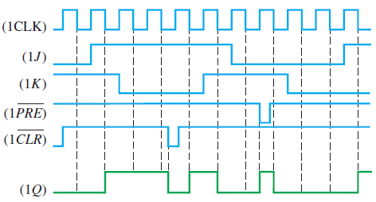
JK Flip-Flops with Asynchronous Inputs
Exercise 6:
SOLUTION

Slide 24
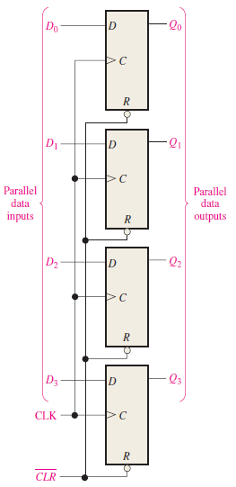
Application of Flip-Flops
DATA STORAGE
D flip-flops can be used as parallel data storage devices.
Multiple D flip-flops are connected in parallel.
For a N-bit data, N no. of flip-flops are required.
The data is stored at the triggering edge of the clock pulse.
Figure shows a 4-bit positive edge triggered data storage device.
The same clock is parallel connected to all the flip-flops.
The input of the flip-flops are connected to the data bus.
At every clock pulse, the data in the data bus gets stored in the flip-flops.
The device also has common asynchronous Clear input.
When the memory is needed to emptied, the Clear input is set to LOW.

Slide 25
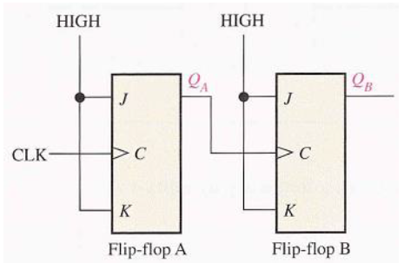
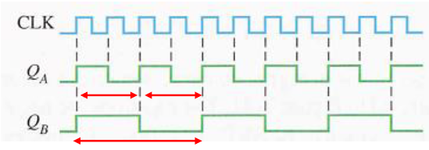
Application of Flip-Flops
FREQUENCY DIVISION
JK flip-flops can be used to slow down clocks.
It is also known as frequency division.
The JK flip-flop is operated in the toggle mode.
Each flip-flop divides the frequency by 2.
There fore, N flip-flops can be connected in series to divide the frequency by 2^{N}.
A benefit of using flip-flops for frequency division is that the duty cycle is exactly 50%.
The figure shows the arrangement to divide the clock frequency by 4.

Slide 26
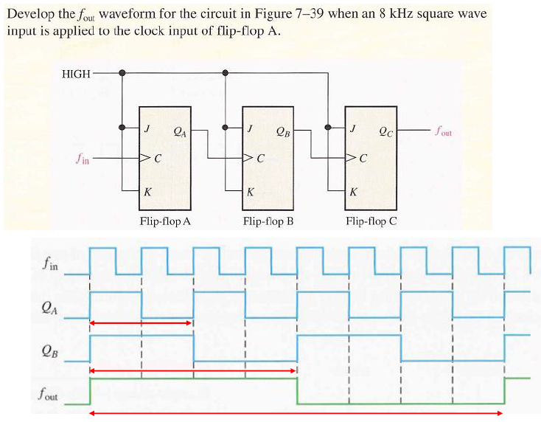
Application of Flip-Flops

Slide 27
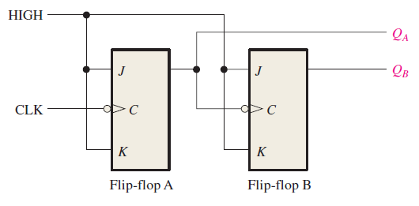
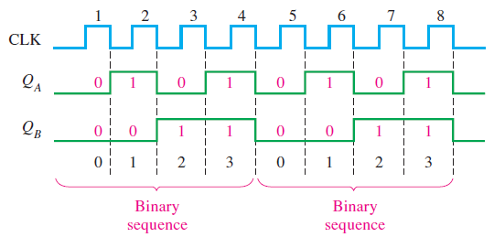
Application of Flip-Flops
COUNTING
Flip-flops can also be used to make digital counters.
JK flip-flops are used to make counters.
JK flip-flop is operated in the toggle mode.
N flip-flops are required for N-bit counters.
Counters can be synchronous or asynchronous.

Slide 28
References
Thomas L. Floyd, “Digital Fundamentals” 11th edition, Prentice Hall – Pearson Education.
Thank You

